Slide 1
Social Movements
POLS 1101

Slide 2
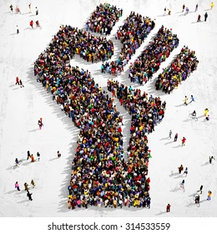
Social Movements
Definition: loosely organized groups with large numbers of people who use unconventional and often disruptive tactics to have their grievances heard by the public, the news media, and government.
Often led by political outsiders
Usually massive grassroots phenomena
Members have a shared grievance
Use of disruptive tactics
Often turn into interest groups

Slide 3


Slide 4

WARNING
Please note that the Civil Rights Movement and BLM will be covered in depth during the Civil Rights chapter. They are certainly a social movement that could be included here
There are MANY social movements that we do not have time to cover in detail, but they are still important.

Slide 5
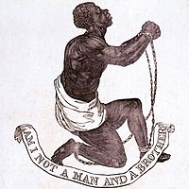
Major Social Movements - Abolition
Goal: ending the institution of slavery in the United States
Active Period: 19th century
Early motivation were religious
Influenced by British abolition (Slavery abolition Act of 1833)
Tactics were both violent and nonviolent

Slide 6
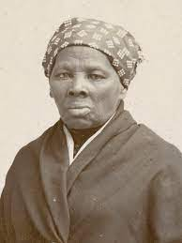
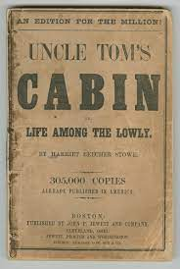
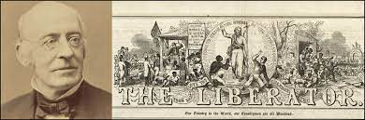
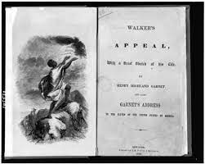
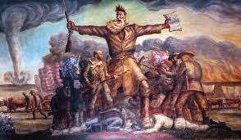
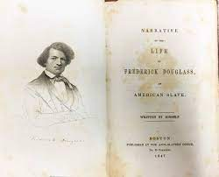
Abolition
Notes:
William Llyod Garrison; Harriet Tubman, Harriet Beecher Stowe’s Uncle Tom’s Cabin; Frederick Douglas, David Walker’s Appeal; John Brown

Slide 7
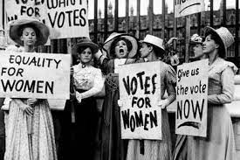
Major Social Movements – Women’s Suffrage
Many of those in the abolition movement would be early leaders in the fight for women’s suffrage (Susan B. Anthony, Sojourner Truth, etc)
Goal: the right to vote; political and social equality
Active Period: (various stages from founding to today)
Laws of coverture: women couldn’t own property, they were ‘owned’ by their husband.

Slide 8
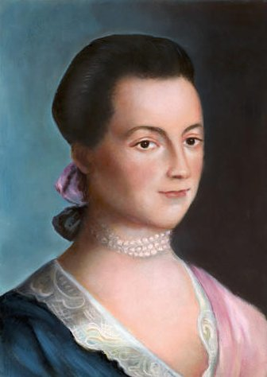
Remember the Women
“I long to hear that you have declared an independency. And, by the way, in the new code of laws which I suppose it will be necessary for you to make, I desire you would remember the ladies and be more generous and favorable to them than your ancestors. Do not put such unlimited power into the hands of the husbands. Remember, all men would be tyrants if they could. If particular care and attention is not paid to the ladies, we are determined to foment a rebellion, and will not hold ourselves bound by any laws in which we have no voice or representation.”
- Abigail Adams, Letter to John Adams, March 31, 1776

Slide 9
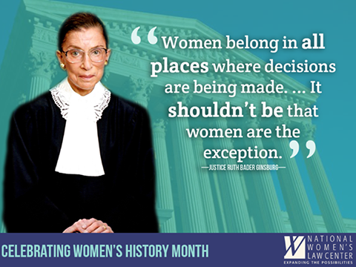
Women’s Rights
Seneca Falls Convention (1848) Declaration of Sentiments
Jeannette Rankin (1917) first woman elected to the House of Reps (Montana)
19th Amendment (1920)
Sandra Day O’Connor (1981) first
woman appointed to SCOTUS
Kamala Harris (2021) first VP
Women earn 84% of what men do
Lilly Ledbetter Fair Pay
Act (2007)
Equal Rights Amendment
proposed since 1923
Notes:
http://www.pewresearch.org/fact-tank/2015/04/14/on-equal-pay-day-everything-you-need-to-know-about-the-gender-pay-gap/

Slide 10
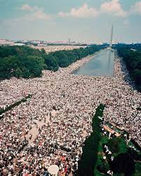
Major Social Movements – Anti-War
As long as there has been war, there have been movements opposing it.
Focus: Vietnam War Protests
Vietnam grew out of the Cold War
Methods: teach-ins, public protests, destroying/bombing draft offices, voter registration, etc. (Also tied into Civil Rights Movement)

Slide 11
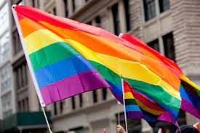
Major Social Movements - LGBTQ
Why? Denial of basic rights, including the right to exist (“Liberation” of Nazi camps, pink triangles)
Began in the 1960’s to gain rights and protections
1961 – Illinois first state to decriminalize sodomy
June 28, 1969 – Riots at Stonewall
1992 Don’t Ask Don’t Tell, Repealed in 2011
June 2015 – Obergefell v. Hodges, DOMA unconstitutional, legalized ‘gay’ marriage
2020 – Bostock v. Clayton County, Georgia, CRA protects gay and transgender workers from discrimination
Notes:
This decision resulted from three cases: Altitude Express Inc. v. Zarda and Bostock v. Clayton County, Georgia, in which gay men were fired because of their sexual orientation, and R.G. & G.R. Harris Funeral Homes Inc. v. Equal Employment and Opportunity Commission, where a transgender woman was fired because of her gender identity.

Slide 12
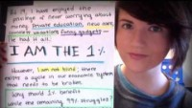
Major Social Movements – Occupy Wall Street

Slide 13
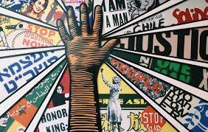
Social Movements & Democracy
Encouraging Participation
Giving power to marginalized groups
Creating new majorities
Forcing the mainstream to recognize a perceived injustice

Slide 14
Creating a Movement
Identifying a real or perceived injustice
Resource mobilization: identifying allies, supporters, leaders, etc
Determining a strategy and message
Violence vs. Non-violence
Having a message that appeals to the masses
Working within a system that is at least tolerant of the movement
Belief that success is possible
Risk vs. Reward
Spark to Set Off the Flame

Slide 15
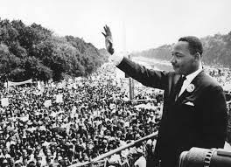
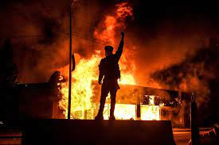
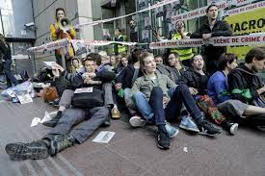
Tactics of Social Movements
No set ‘rule-book’
Often includes:
Education
Forcing public recognition of the issue
Mobilizing support
Protests at the site of injustice
Note: the method of protest has never been considered acceptable to those benefiting from the oppression
What would you be willing to do for a cause?

